Slide 1
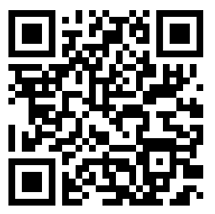
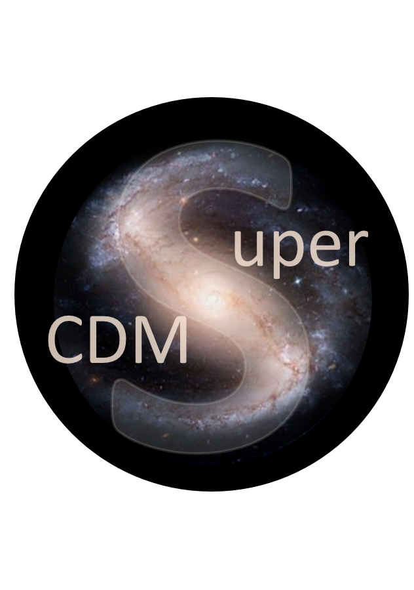



Dark matter data analysis made easy. Complex software environments through Docker containers. No installation necessary!
Non-Cognitive Predictors of Student Success: A Predictive Validity Comparison Between Domestic and International Students
INTRO
Getting my software to work on your computer will take months. It isn’t always easy, or worthwhile
Goal is to provide a one-stop shop for data analysis across a collaboration
Streamlining Dark Matter Data Analysis with Docker and JupyterLab
Josh Elsarboukh Advised by: Dr. Amy Roberts
INTRO
Getting my software to work on your computer will take months. It isn’t always easy, or worthwhile
Goal is to provide a one-stop shop for data analysis across a collaboration
APPROACH
Analysis software is packaged in a portable way, such as Python install script
Software gets installed into a Docker container using my Dockerfile
JupyterLab provides interface for file interaction, text editing, etc.
Kubernetes is used to orchestrate deployment and management of finalized containers
RESULTS
Eliminates users’ need for complicated software installation
Users all work within the same software environment, streamlining maintenance and development
SEEKING SOLUTIONS
Need an effective way to test changes to code without rebuilding the entire image
Automate build process when relevant code is updated
An efficient caching system, for longer lived containers
The Dockerfile
Take a picture to see the code!
Contact Me:
joshua.elsarboukh@ucdenver.edu
github.com/glass-ships
Notes:
Notes:
In Powerpoint, click View > Guides
Keep text within gutter guides.
Author list: Don’t split names onto two lines (e.g., “Jimmy [break] Smith”). If that happens, use a new line, unless you need the space. Bold the first names of anybody who’s presenting in person.
Intro/methods/result: Do not drop below font size 28, but if you have extra space, jack up the font size until the space is full.
Do not use color in the sidebars except in graphs/figures. It’ll pull attention from the center and slow interpretation for passersby.

